Slide 1

Case Study
BUILDING A SALES PERFORMANCE DASHBOARD FOR A PIZZERIA
Presented by Francisco Ferreira

Slide 2
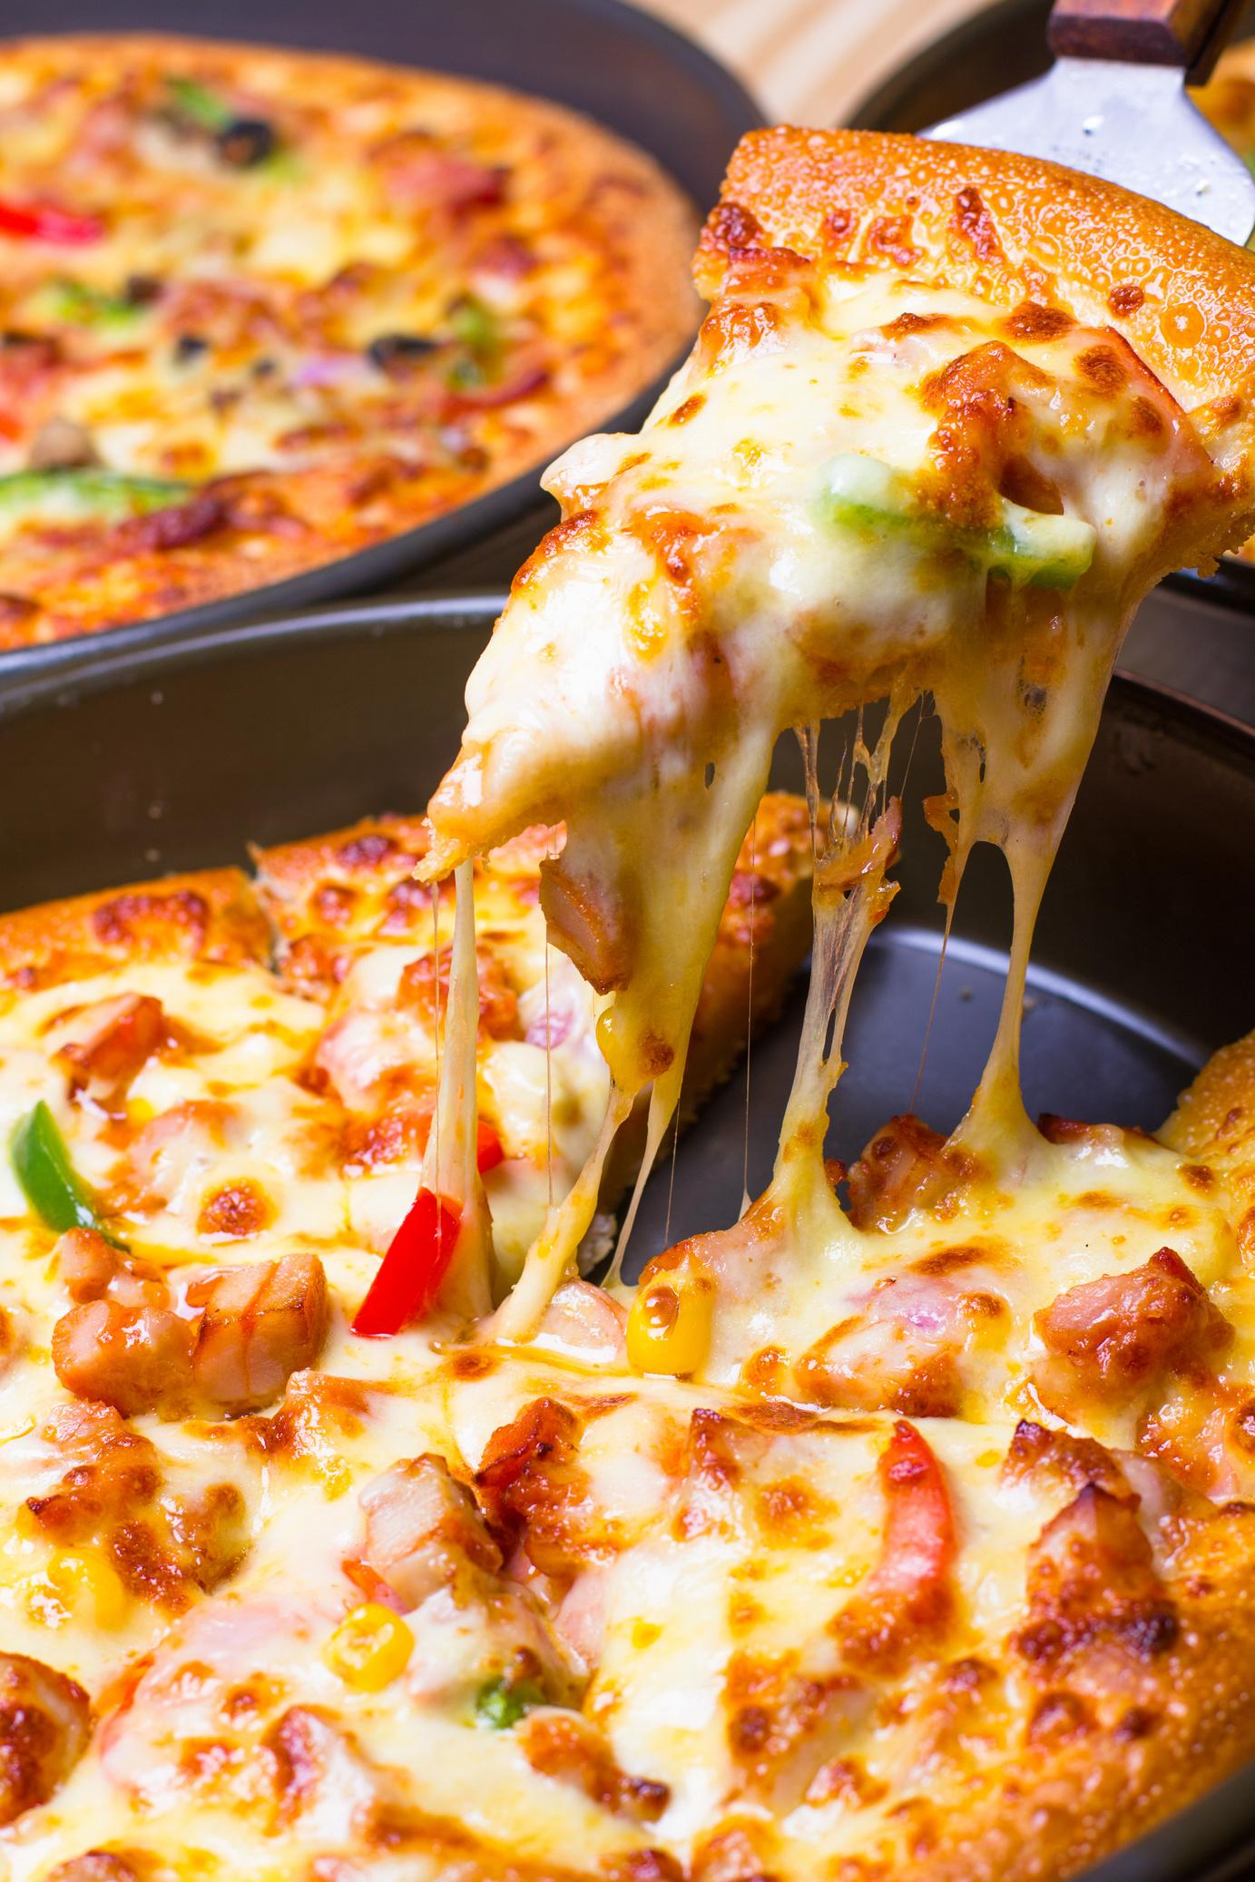
Background
A local pizzeria has experienced consistent growth over the past year, with an increasing volume of online and in-store orders.
However, management lacks a centralized view of performance trends, customer behavior, and product demand. Decisions around staffing, promotions, and menu updates are often made without data to support them.
To improve operational efficiency and business intelligence, it is necessary to build a comprehensive, interactive sales dashboard that brings clarity to sales performance at a glance.

Slide 3

Objectives
The main goal of this project is to develop a data dashboard that helps the business answer key performance questions and make data-driven decisions.
The dashboard will provide real-time visibility into:
Sales trends across different days and hours.
The popularity of various pizza categories and sizes.
Top-performing and underperforming pizza items.
Customer purchasing behavior patterns.

Slide 4
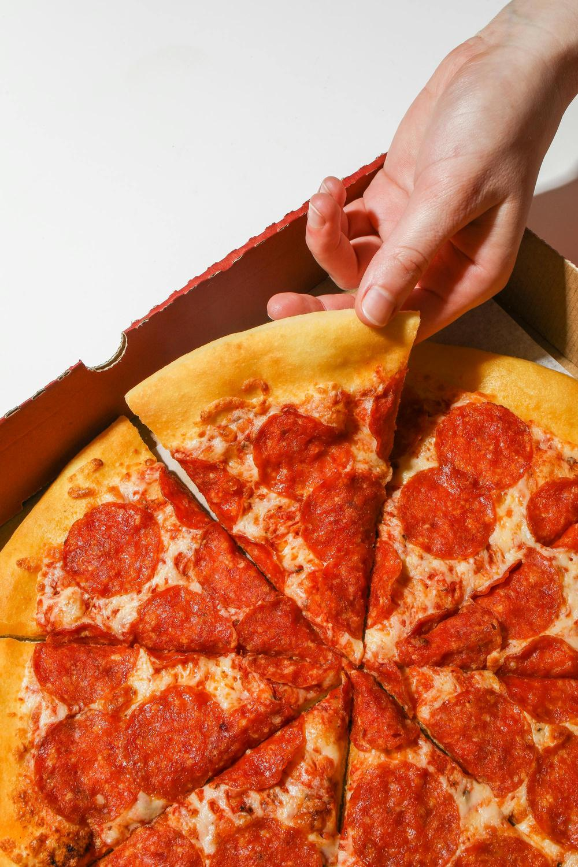
Dashboard Design Overview
The dashboard will feature several interactive charts and KPIs designed to give both high-level insights and granular views into sales dynamics.
KPI Summary Tiles:
Total Revenue
Total Orders
Average Order Value
Total Pizzas Sold
Average Pizzas per Order

Slide 5

Core Visualizations
Daily Order Trend
Pizzas Sold by Category
Hourly Order Trend
Top 5 Best Sellers
Sales by Pizza Category
Bottom 5 Worst Sellers
Sales by Pizza Size

Slide 6
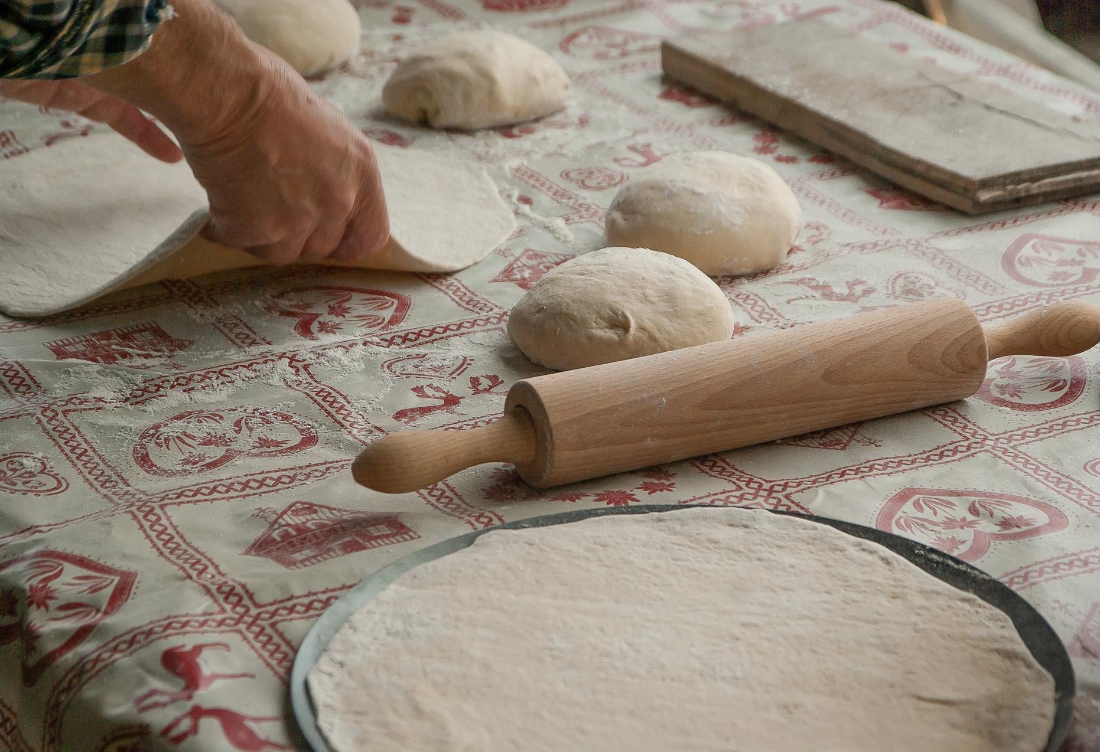
Tools & Visualizations
SQL Tool: Google Cloud Console – Bigquery.
Visualization: MS Office/Excel.
Data Cleaning & Querying: Google Cloud Console.

Slide 7
Thank You
Presented by Francisco Ferreira
EMAIL
fsemedo2001@hotmail.com
PHONE
+351 962 697 540
WEBSITE
portfolio

